Slide 1
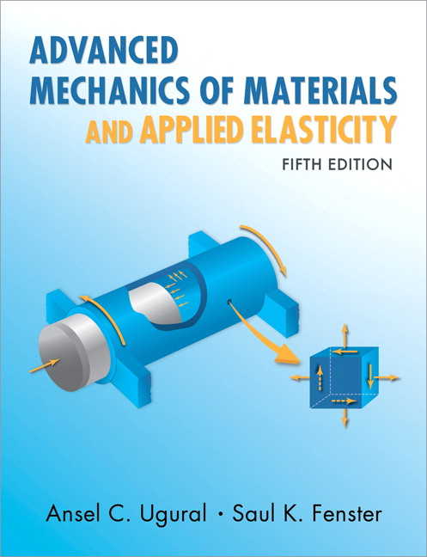
Advanced Mechanics
(Lecture 13)
ANNOUNCE / BUSINESS
HW 5 (due Today)
HW 6 (due next week)
PREVIOUS
Concentrated loads
Stress concentrations
TODAY
Contact stresses

Slide 2
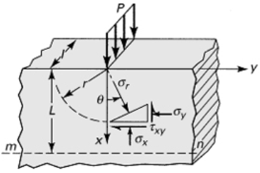

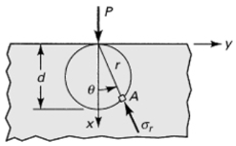

Concentrated Loads
Concentrated load on a semi-infinite plate
Using solution for compression of wedge with $α=π/2$
Note this predicts that radial stress magnitude is constant around circle of diameter d

Slide 3
Contact Stresses

Slide 4
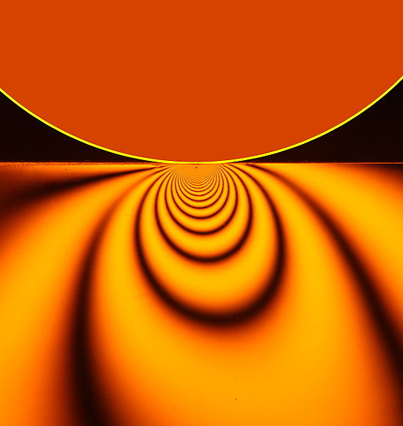
Contact Stresses
High stresses resulting from application of force over small surface (but not a point load)
Happen everywhere; often ignored / negligible
First analysis of elastic contact stress by Hertz in 1881; thus, Hertz contact stresses
Analysis of ideal shapes, but relevant to components like ball and roller bearings, gear teeth, cams, etc
Solutions seek to define contact area, distribution of pressure, and underlying stresses
(Wikipedia)
Notes:
Image shows stress contours obtained via photoelasticity

Slide 5
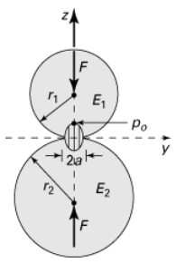
Contact Stresses
Assumptions:
Materials are isotropic and elastic
Contact areas are flat during deformation
Surfaces are perfectly smooth (normal stresses only at surface)
Solutions via methods of linear elasticity, but we will focus on results and on learning to apply resulting relationships
In all cases, contact pressure varies from zero at edge of contact area to maximum at center

Slide 6
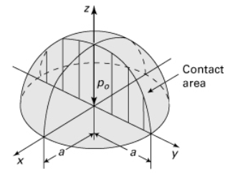

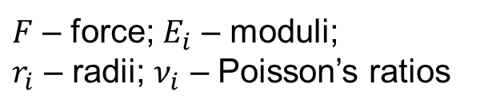

Two Spheres
Contact area is circular ($area=πa^{2}$)
Pressure distribution is semi-elliptical
$F$ – force; $E_{i}$ – moduli;
$r_{i}$ – radii; $ν_{i}$ – Poisson’s ratios

Slide 7
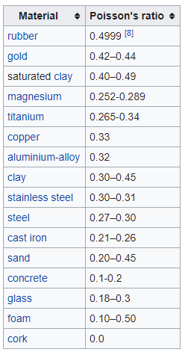



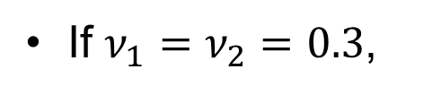
Two Spheres
Maximum contact pressure (maximum principal stress)
If $ν_{1}=ν_{2}=0.3$,
Relative displacement (of sphere centers; $ν_{1}=ν_{2}=0.3$):

Slide 8
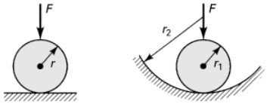
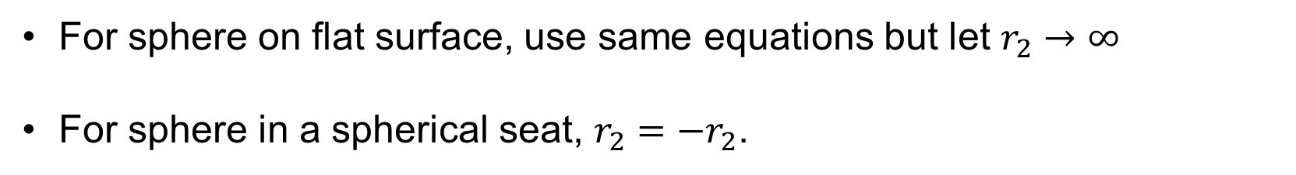
Variations with Spherical Contact
For sphere on flat surface, use same equations but let $r_{2}→∞$
For sphere in a spherical seat, $r_{2}=−r_{2}$.

Slide 9
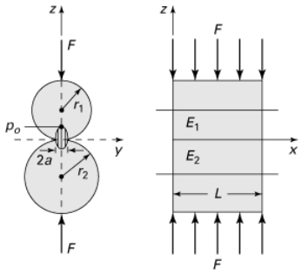


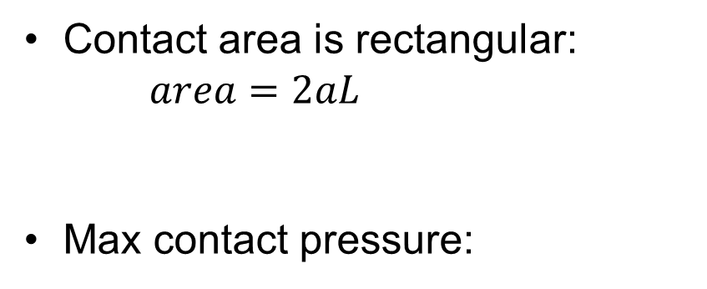
Two Parallel Cylinders
Contact area is rectangular: $area=2aL$
Max contact pressure:
where

Slide 10
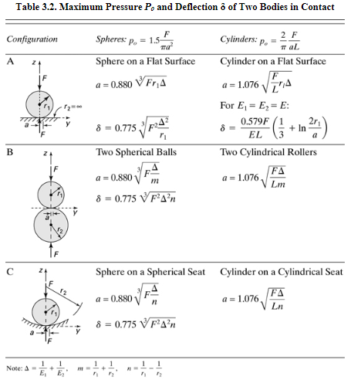


$$m$$
* note that soft object dominates results for contact area and displacement:
$Δ=\frac{1}{E_{1}}+\frac{1}{E_{2}}=\frac{E_{1}+E_{2}}{E_{1}E_{2}}$. If $E_{1}≫E_{2}$, $Δ≈\frac{E_{1}}{E_{1}E_{2}}=\frac{1}{E_{2}}$
* all formulae in this table assume $ν=0.3$

Slide 11
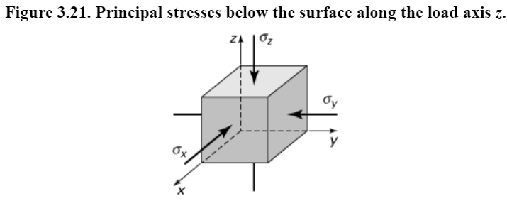
Contact Stress Distribution
Compression in direction of applied load ($z$) causes the element to expand transversely, but surrounding material resists, leading to a state of triaxial compression
Notes:
Consider Mohr’s circle and max shear stress (see upcoming plots)

Slide 12
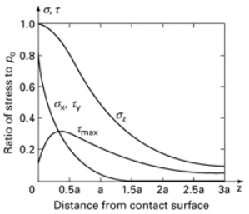


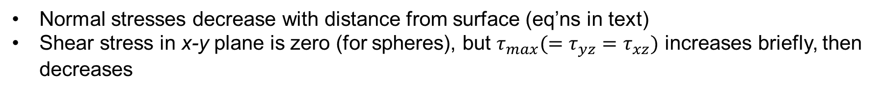
Contact Stress Distribution
2 spheres
σ_{y}
* Note that the normal stresses given are principal; i.e., shear stress is only non-zero with change of coordinates
Normal stresses decrease with distance from surface (eq’ns in text)
Shear stress in x-y plane is zero (for spheres), but $τ_{max}(=τ_{yz}=τ_{xz})$ increases briefly, then decreases

Slide 13
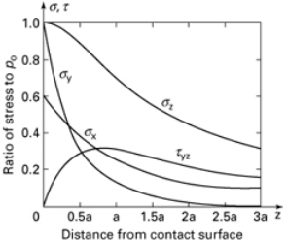
Contact Stress Distribution
2 spheres
2 parallel cylinders
σ_{y}
Normal stresses decrease with distance from surface (eq’ns in text)
Shear stress in x-y plane is zero (for spheres), but $τ_{max}(=τ_{yz}=τ_{xz})$ increases briefly, then decreases

Slide 14
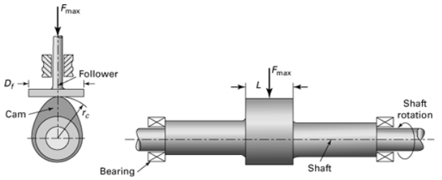
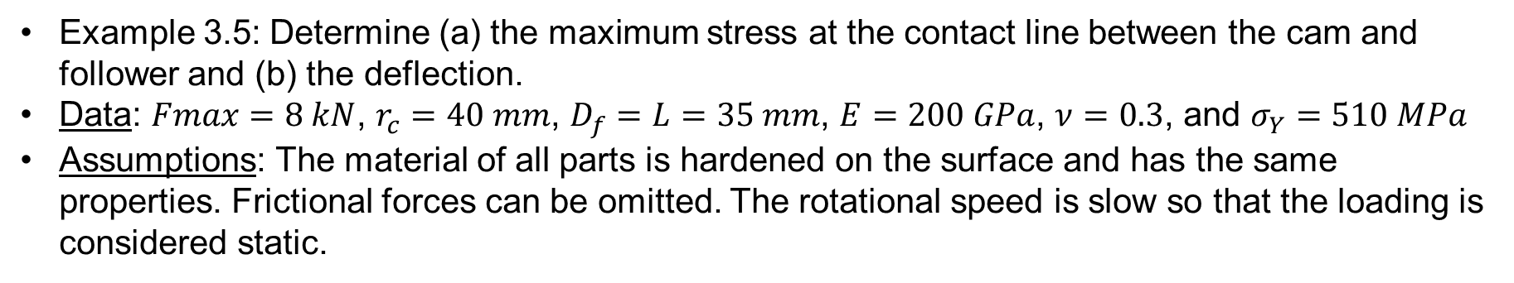
Example – Cam and Follower
Example 3.5: Determine (a) the maximum stress at the contact line between the cam and follower and (b) the deflection.
Data: $Fmax=8 kN$, $r_{c}=40 mm$, $D_{f}=L=35 mm$, $E=200 GPa$, $ν=0.3$, and $σ_{Y}=510 MPa$
Assumptions: The material of all parts is hardened on the surface and has the same properties. Frictional forces can be omitted. The rotational speed is slow so that the loading is considered static.

Slide 15
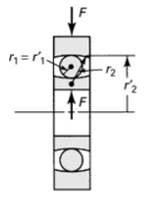
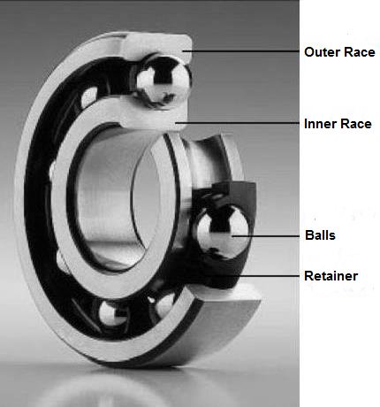
General Contact
Can we use what we’ve learned about contact so far to evaluate the stress in a ball bearing?
Notes:
Equations we’ve learned about aren’t appropriate for this geometry.

Slide 16
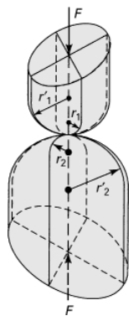
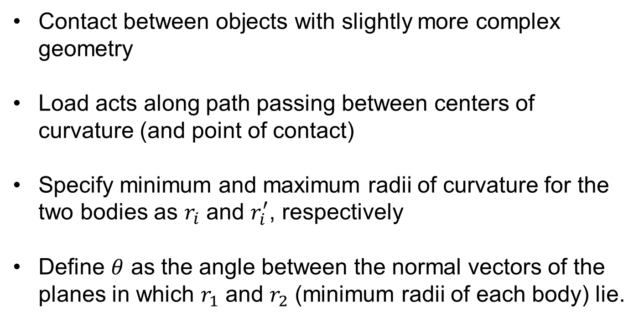
General Contact
Contact between objects with slightly more complex geometry
Load acts along path passing between centers of curvature (and point of contact)
Specify minimum and maximum radii of curvature for the two bodies as $r_{i}$ and $r_{i}^{′}$, respectively
Define $θ$ as the angle between the normal vectors of the planes in which $r_{1}$ and $r_{2}$ (minimum radii of each body) lie.
Notes:
Two elliptical bars with rounded ends

Slide 17



General Contact
Maximum contact pressure is
Area of contact is elliptical, where semi-axes are given by
and

Slide 18
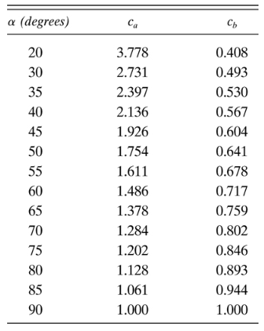




General Contact
What about $c_{a}$ and $c_{b}$?
Read from Table 3.3
where $cosα=B/A$ and

Slide 19
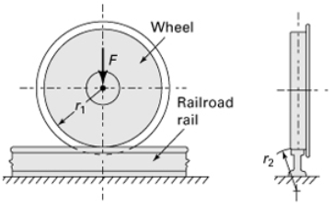
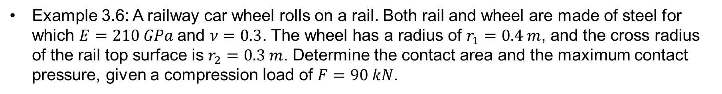
General Contact
Example 3.6: A railway car wheel rolls on a rail. Both rail and wheel are made of steel for which $E=210 GPa$and $ν=0.3$. The wheel has a radius of $r_{1}=0.4 m$, and the cross radius of the rail top surface is $r_{2}=0.3 m$. Determine the contact area and the maximum contact pressure, given a compression load of $F=90 kN$.

Slide 21
General Contact
Consider case where curvature is negative … ball bearing in race – evaluate contact between bearing and outer race (homework!)

